Slide 1

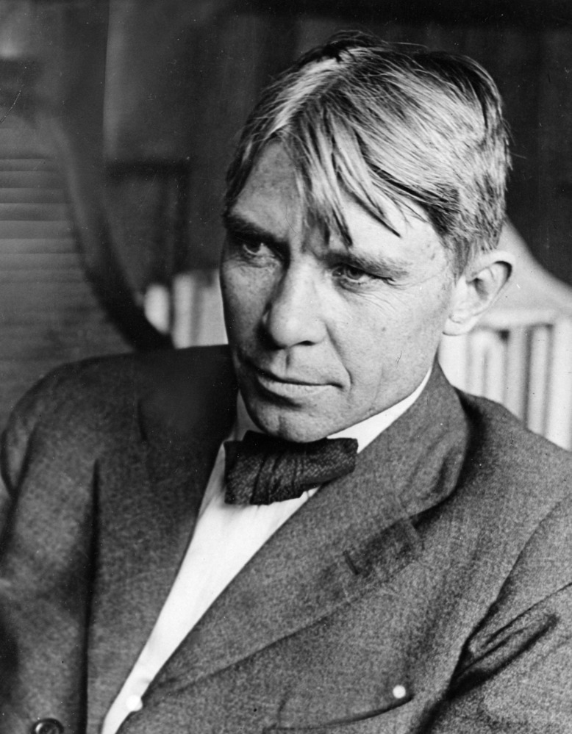
"Poet of the People“
Carl Sandburg provided a popular voice for the American people of the twentieth century and still speaks to us through his words, activism, music and the beauty and serenity of Carl Sandburg Home National Historic Site.
www.nps.gov/carl

Slide 2
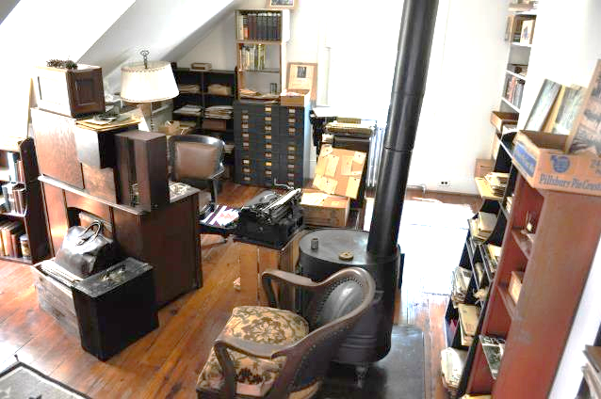
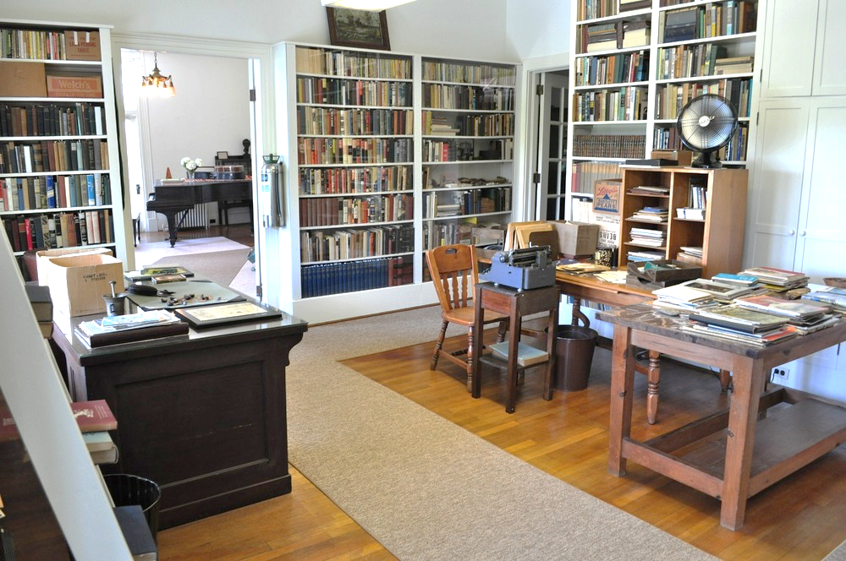
Carl Sandburg’s Connemara
Grades 6th-8th
Carl Sandburg lived at Connemara for the last 22 years of his life.
What inferences can you make about Carl Sandburg based on the objects he had in his home?
Tasks:
1) Complete the activating strategy on slide 3. What object describes you?
2) Watch the video on slide 4 to learn about Carl Sandburg’s Connemara.
3) Take a Virtual Tour of Connemara on slide 8.
4) Write to explain what you infer about Carl Sandburg based on one object that you saw on the tour.

Slide 3
If you were to pick just one object to describe you what would it be?
Insert a picture of that object and write to explain why that object describes you.
What does that object tell someone about you?
Place object in this box
Write your answer here:

Slide 4
Carl Sandburg’s Connemara
Click this link https://www.youtube.com/watch?v=jS0TJT6H_KE
to learn about Carl Sandburg’s Connemara.
As you watch you can pause the video and make notes about what objects you see in his house.
  What do you notice about the house?
  How is the house similar or different from your house?
  What do you notice about the objects in the house?
  Is there anything that surprised you?
Then, look at the objects and descriptions on the next three slides to see what those objects tell us about Carl Sandburg.

Slide 5
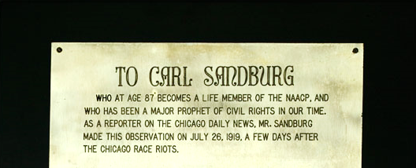
Life Membership to the NAACP Plaque
Carl Sandburg as a newspaper columnist covered the Chicago Race Riots in 1919. These articles were compiled into a book of the same name shortly thereafter. Sandburg stated that “pride of race will come to the negro when a dark skin is no longer associated with poverty, misery, terror and insult.” The NAACP President Roy Wilkens called Sandburg, “a major prophet of Civil Rights in our time.” Sandburg was very proud of this award. It was one of a very few that he kept in daily view.

Slide 6
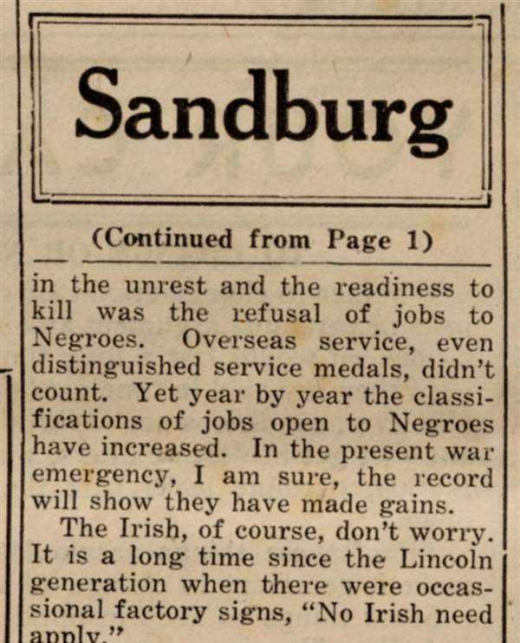
Galesburg Post News Article
Sandburg takes on the issue of race in the context of the world war in a 1942 article for the Chicago Times, reprinted here in the Galesburg Post on June 4, 1942 entitled, "We Have Yet Another Front To Conquer--"The Color Line." In it Sandburg talks of the progress we have made as a nation, albeit slow progress, opening up jobs for the 'Negro' at a higher rate than that after World War I. He talks of the idiocy of Hitler's idea of a perfect race and believes America has done pretty well so far stating, "On paper, in the national documents, in the solemn covenants that rooted us as a nation, we are for all races, breeds and folk, bar none. And considering the size of our country and the variety of breeds and cross-breeds and hybrids and incalculable polyglots, we haven't done so bad. Wicked faults we have but it might be worse."

Slide 7
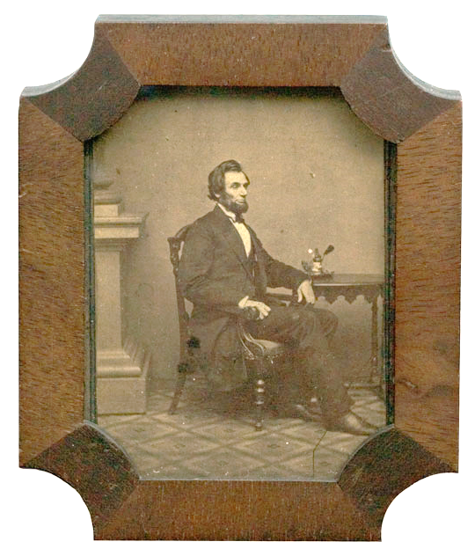
Abraham Lincoln Daguerreotype
This daguerreotype of Lincoln is part of Sandburg's impressive collection of Lincoln memorabilia. The daguerreotype was an early form of photography created by Louis Daguerre in 1839.

Slide 8
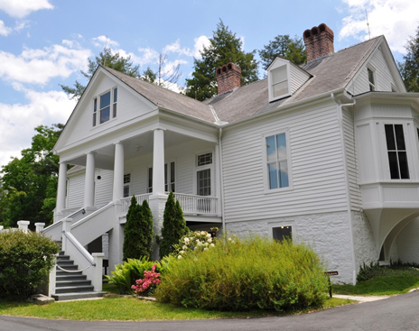
Click this link https://carl.oncell.com/en/sandburg-home-tour-92015.html to take a virtual tour to explore Carl Sandburg Home NHS.
As you take the tour, think about what you notice about Carl Sandburg’s home. Choose one object in the house that you think best represents Sandburg. On the next slide, write to explain what this object tells you about Carl Sandburg.

Slide 9
What inferences can you make about Carl Sandburg based on the object you found in his home?
What details in the object support your opinion?
Add a picture or screenshot from the virtual tour with your writing.
Place picture in this box
Write your answer here:

